Slide 1

Post-Evaluation Model of -
Multiple Award Schedule (MAS) Using Fuzzy Theory
Su Young Yang¹, Jae Min Lim¹, Eun Hyo Lee², Yeon Kyung Lee¹, Jin Hee Yoon¹
¹Department of Mathematics and Statistics, Sejong University
²Department of Computer engineering, Sejong University

Slide 2
01
Introduction
02
Fuzzy numbers
03
Post-evaluation function for fuzzy data
04
Data Analysis using Fuzzy Post-Evaluation Model
05
Conclusion
2/29

Slide 3
PART
01
Introduction

Slide 4

MAS: Multiple Award Schedule
product company
Contract
Payment
Delivery and inspection of goods
Flow chart
PPS
Public Procurement Service
Demand
Purchasing goods
Checking and selecting procurement of goods
4/29

Slide 5

ambiguous information can be lost.
5/29

Slide 6
PART
02
Fuzzy numbers

Slide 7
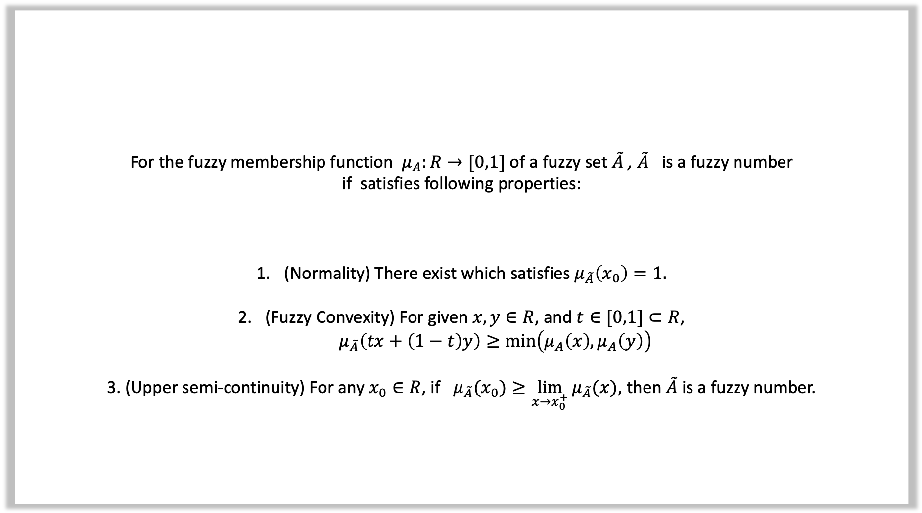
For the fuzzy membership function $μ_{A}:R→[0,1]$ of a fuzzy set $\tilde{A}$ , $\tilde{A}$ is a fuzzy number
if satisfies following properties:
(Normality) There exist which satisfies $μ_{\tilde{A}}\left(x_{0}\right)=1.$
2. (Fuzzy Convexity) For given $x,y∈R$, and $t∈[0,1]⊂R$,
$μ_{\tilde{A}}\left(tx+\left(1−t\right)y\right)≥\min\left(μ_{A}\left(x\right), μ_{A}\left(y\right)\right)$
3. (Upper semi-continuity) For any $x_{0}∈R$, if $μ_{\tilde{A}}(x_{0})≥\lim_{x→x_{0}^{+}}{μ_{\tilde{A}}(x)}$, then $\tilde{A}$ is a fuzzy number.
Definition 1 (Fuzzy number)
7/29

Slide 8
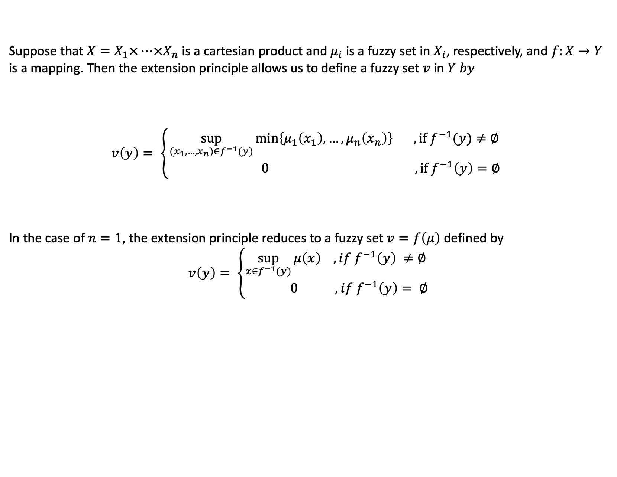
Zadeh’s extension principle
Suppose that $X=X_{1}×…×X_{n}$ is a cartesian product and $μ_{i}$ is a fuzzy set in $X_{i}$, respectively, and $f:X→Y$
is a mapping. Then the extension principle allows us to define a fuzzy set $v$ in $Y by$
$$v\left(y\right)= \left\{\begin{aligned}\sup_{(x_{1},…,x_{n})∈f^{−1}(y)}\min\left\{μ_{1}\left(x_{1}\right),…,μ_{n}\left(x_{n}\right)\right\} ,if f^{−1}(y)≠∅ \\ 0 ,if f^{−1}\left(y\right)=∅ \end{aligned}\right.$$
In the case of $n=1$, the extension principle reduces to a fuzzy set $v=f\left(μ\right)$ defined by
$$v\left(y\right)= \left\{\begin{aligned}\sup_{x∈f^{−1}(y)}{μ\left(x\right) , if f^{−1}\left(y\right) }≠∅ \\ 0 ,if f^{−1}\left(y\right)= ∅\end{aligned}\right.$$
Reference : [11]L. A. Zadeh. Fuzzy sets. Information and Control, 8:338–353, 1965.
8/29

Slide 9
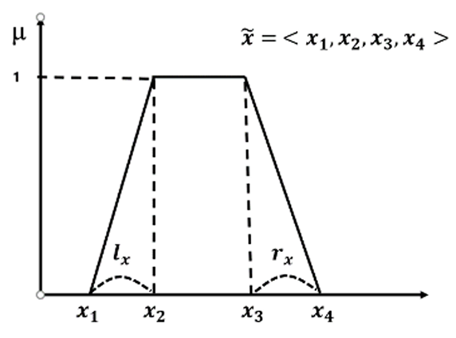
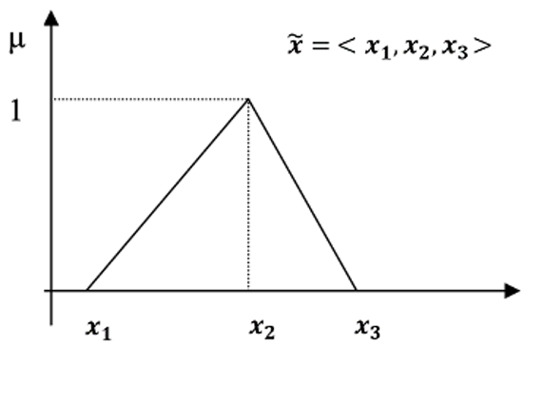
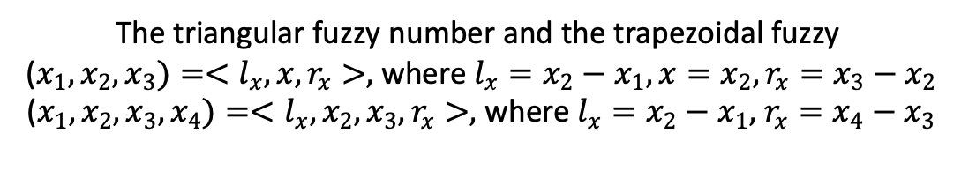
Membership functions for triangular and trapezoidal fuzzy numbers
Figure 1. Membership functions for triangular and trapezoidal fuzzy numbers
The triangular fuzzy number and the trapezoidal fuzzy
($x_{1}, x_{2}, x_{3})=<l_{x}, x, r_{x}>,$ where $l_{x}=x_{2}−x_{1}, x=x_{2}, r_{x}=x_{3}−x_{2}$
($x_{1}, x_{2}, x_{3}, x_{4})=<l_{x}, x_{2}, x_{3}, r_{x}>,$ where $l_{x}=x_{2}−x_{1},$ $r_{x}=x_{4}−x_{3}$
9/29

Slide 10
PART
03
Post-evaluation function for fuzzy data

Slide 11
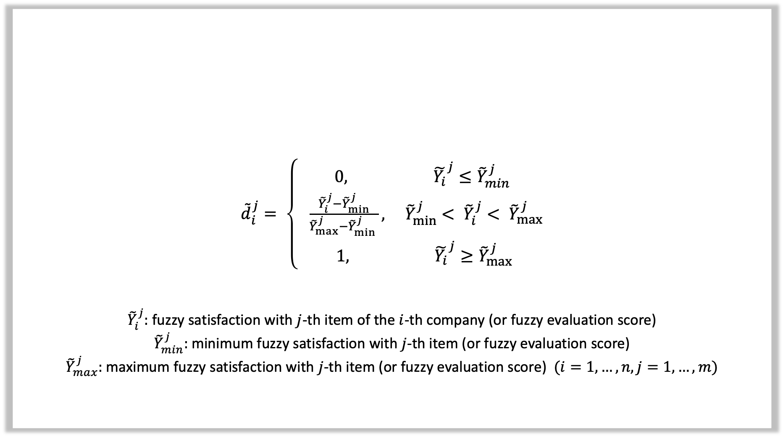
${\tilde{d}}_{i}^{j}= \left\{ \begin{aligned}0, {\tilde{Y_{i}}}^{j}≤{\tilde{Y}}_{min}^{j} \\ \frac{{\tilde{Y}}_{i}^{j}−{\tilde{Y}}_{min}^{j}}{{\tilde{Y}}_{max}^{j}−{\tilde{Y}}_{min}^{j} }, { \tilde{Y}}_{min}^{j}< {\tilde{Y}}_{i}^{j}< {\tilde{Y}}_{max}^{j} \\ 1, {\tilde{Y_{i}}}^{j}≥{\tilde{Y}}_{max}^{j} \end{aligned}\right.$
${\tilde{Y}}_{i}^{j}:$fuzzy satisfaction with $j$-th item of the $i$-th company (or fuzzy evaluation score)
${\tilde{Y}}_{min}^{j}:$minimum fuzzy satisfaction with $j$-th item (or fuzzy evaluation score)
${\tilde{Y}}_{max}^{j}:$maximum fuzzy satisfaction with $j$-th item (or fuzzy evaluation score)$(i=1,…,n, j=1,…,m)$
Proposed One-sided Fuzzy Reliability Function
11/29

Slide 12
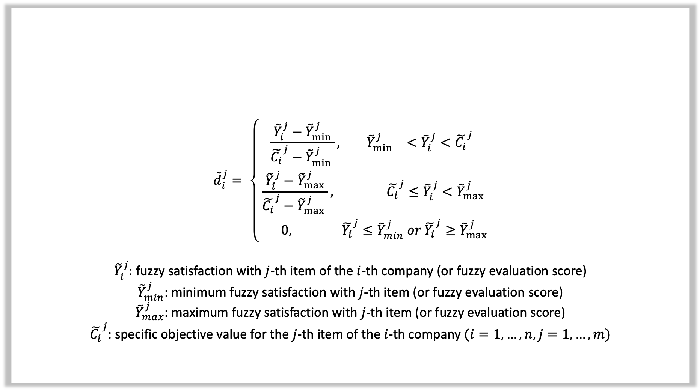
$${\tilde{d}}_{i}^{j}= \left\{\begin{aligned}\frac{{\tilde{Y}}_{i}^{j}−{\tilde{Y}}_{min}^{j}}{{\tilde{C_{i}}}^{j}−{\tilde{Y}}_{min}^{j} }, { \tilde{Y}}_{min}^{j}<{\tilde{Y}}_{i}^{j}<{\tilde{C_{i}}}^{j} \\ \frac{{\tilde{Y}}_{i}^{j}−{\tilde{Y}}_{max}^{j}}{{\tilde{C_{i}}}^{j}−{\tilde{Y}}_{max}^{j} }, {\tilde{C_{i}}}^{j}≤{\tilde{Y}}_{i}^{j}<{\tilde{Y}}_{max}^{j} \\ 0, {\tilde{Y_{i}}}^{j}≤{\tilde{Y}}_{min}^{j} or {\tilde{Y_{i}}}^{j}≥{\tilde{Y}}_{max}^{j}\end{aligned}\right.$$
${\tilde{Y}}_{i}^{j}:$fuzzy satisfaction with $j$-th item of the $i$-th company (or fuzzy evaluation score)
${\tilde{Y}}_{min}^{j}:$minimum fuzzy satisfaction with $j$-th item (or fuzzy evaluation score)
${\tilde{Y}}_{max}^{j}:$maximum fuzzy satisfaction with $j$-th item (or fuzzy evaluation score)
${\tilde{C_{i}}}^{j}$: specific objective value for the $j$-th item of the $i$-th company $(i=1,…,n, j=1,…,m)$
Proposed Two-sided Fuzzy Reliability Function
12/29

Slide 13
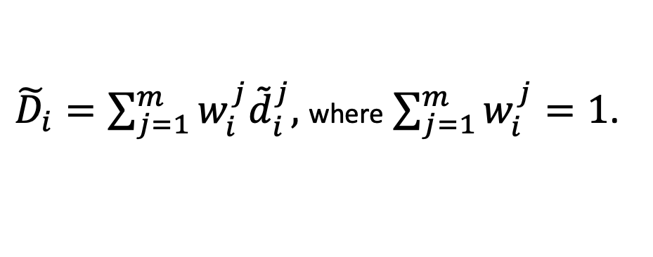
Post-evaluation function using fuzzy scale
a Post-evaluation function ${\tilde{D}}_{i}$ using a fuzzy scale in which the result of fuzzy satisfaction evaluation ${\tilde{d}}_{i}^{j}$
the importance of item $j$ of the $i$-th company is defined as $w_{i}^{j}\left(i=1,…,n, j=1,…,m\right)$
${\tilde{D}}_{i}=\sum_{j=1}^{m}{w_{i}^{j}{\tilde{d}}_{i}^{j}, }$ where$\sum_{j=1}^{m}{w_{i}^{j}}=1$.
13/29

Slide 14

Definition 2 (Operation of Triangular fuzzy number using function principle)
triangular fuzzy numbers: Let $\tilde{X}=(X_{l}, X,X_{r}) and \tilde{Y}=(Y_{l}, Y,Y_{r})$
(1) Addition: $\tilde{X}+\tilde{Y}=(X_{l}+Y_{l}, X+Y,X_{r}+Y_{r})$
(2) Subtraction: $\tilde{X}−\tilde{Y}=(X_{l}−Y_{r},X−Y,X_{r}−Y_{l})$
(3) Multiplication: $\tilde{X}∙\tilde{Y}=(\min\left(X_{l}Y_{l},X_{l}Y_{r}, X_{r}Y_{l},X_{r}Y_{r}\right),XY,\max\left(X_{l}Y_{l},X_{l}Y_{r}, X_{r}Y_{l},X_{r}Y_{r}\right))$
(4) Division: $\frac{\tilde{X}}{\tilde{Y}}=(\min\left(\frac{X_{l}}{Y_{l}},\frac{X_{l}}{Y_{r}},\frac{X_{r}}{Y_{l}},\frac{X_{r}}{Y_{r}}\right),\frac{X}{Y},\max\left(\frac{X_{l}}{Y_{l}},\frac{X_{l}}{Y_{r}},\frac{X_{r}}{Y_{l}},\frac{X_{r}}{Y_{r}}\right))$
14/29

Slide 15
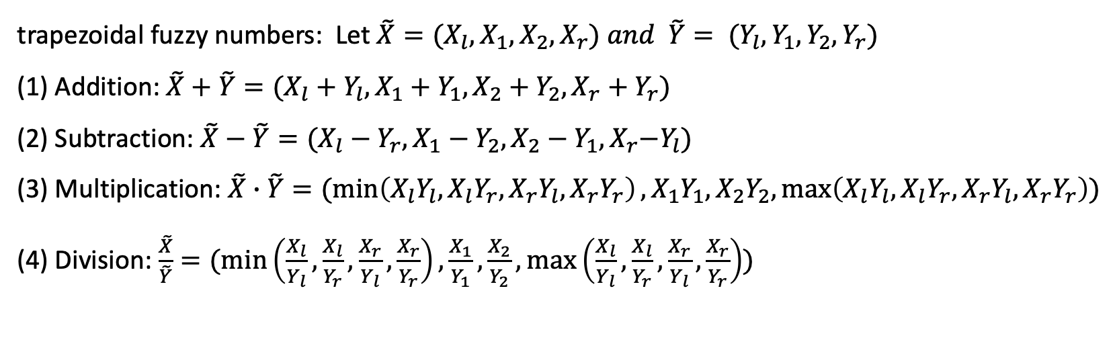
Definition 2 (Operation of Trapezoidal fuzzy number using function principle)
trapezoidal fuzzy numbers: Let $\tilde{X}=(X_{l},X_{1},X_{2},X_{r}) and \tilde{Y}= (Y_{l},Y_{1},Y_{2},Y_{r})$
(1) Addition: $\tilde{X}+\tilde{Y}=(X_{l}+Y_{l}, X_{1}+Y_{1},X_{2}+Y_{2},X_{r}+Y_{r})$
(2) Subtraction: $\tilde{X}−\tilde{Y}=(X_{l}−Y_{r},X_{1}−Y_{2},X_{2}−Y_{1},X_{r}{−Y}_{l})$
(3) Multiplication: $\tilde{X}∙\tilde{Y}=(\min\left(X_{l}Y_{l},X_{l}Y_{r}, X_{r}Y_{l},X_{r}Y_{r}\right),X_{1}Y_{1},X_{2}Y_{2},\max\left(X_{l}Y_{l},X_{l}Y_{r}, X_{r}Y_{l},X_{r}Y_{r}\right))$
(4) Division: $\frac{\tilde{X}}{\tilde{Y}}=(\min\left(\frac{X_{l}}{Y_{l}},\frac{X_{l}}{Y_{r}},\frac{X_{r}}{Y_{l}},\frac{X_{r}}{Y_{r}}\right),\frac{X_{1}}{Y_{1}},\frac{X_{2}}{Y_{2}},\max\left(\frac{X_{l}}{Y_{l}},\frac{X_{l}}{Y_{r}},\frac{X_{r}}{Y_{l}},\frac{X_{r}}{Y_{r}}\right))$
15/29

Slide 16

Definition 3 (New operations for triangular fuzzy numbers using fixed spread)
Let $\tilde{X}=<l_{X}, X,r_{X}>and \tilde{Y}=<l_{Y}, Y,r_{Y}>$ be two triangular fuzzy numbers
And where $l_{X}=X−X_{l}, l_{Y}=Y−Y_{l}, r_{X}=X_{r}−X, and r_{Y}=Y_{r}−Y$
$$(1) \tilde{X}+\tilde{Y}= <l,X+Y, r>$$
$$(2) \tilde{X}−\tilde{Y}= <l,Y−X, r>$$
$$(3) \tilde{X}∙\tilde{Y}= <l,XY, r>$$
$$(4) \frac{\tilde{X}}{\tilde{Y}} = \tilde{X}∙\frac{1}{\tilde{Y}} \left( \frac{1}{\tilde{Y}}= <l,\frac{1}{Y},r> , Y_{1}>0,Y_{2}>0\right)$$
$$(5) k<l,X,r> = <l,kX,r> (k>0)$$
For symmetric fuzzy numbers, we define $l=r$
16/29

Slide 17

Definition 3 (New operations for trapezoidal fuzzy numbers using fixed spread)
Let $\tilde{X}=<l_{X}, X_{1},X_{2},r_{X}>and \tilde{Y}=<l_{Y}, Y_{1},Y_{2},r_{Y}>$ be two trapezoidal fuzzy numbers
And where $l_{X}=X_{1}−X_{l}, l_{Y}=Y_{1}−Y_{l}, r_{X}=X_{r}−X_{2}, and r_{Y}=Y_{r}−Y_{2}$
$$(1) \tilde{X}+\tilde{Y}= <l,X_{1}+Y_{1}, X_{2}+Y_{2}, r>$$
$$(2) \tilde{X}−\tilde{Y}= <l,Y_{1}−X_{2}, Y_{2}−X_{1}, r>$$
$$(3) \tilde{X}∙\tilde{Y}= <l,\min\left\{X_{1}Y_{1},X_{1}Y_{2},X_{2}Y_{1},X_{2}Y_{2}\right\}, max⁡\{X_{1}Y_{1},X_{1}Y_{2},X_{2}Y_{1},X_{2}Y_{2}\}, r>$$
$$(4) \frac{\tilde{X}}{\tilde{Y}} = \tilde{X}∙\frac{1}{\tilde{Y}} \left( \frac{1}{\tilde{Y}}= <l,\frac{1}{Y_{2}},\frac{1}{Y_{1}},r> , Y_{1}>0,Y_{2}>0\right)$$
$$(5) k<l,X_{1},X_{2},r> = <l,kX_{1},kX_{2},r> (k>0)$$
17/29

Slide 18
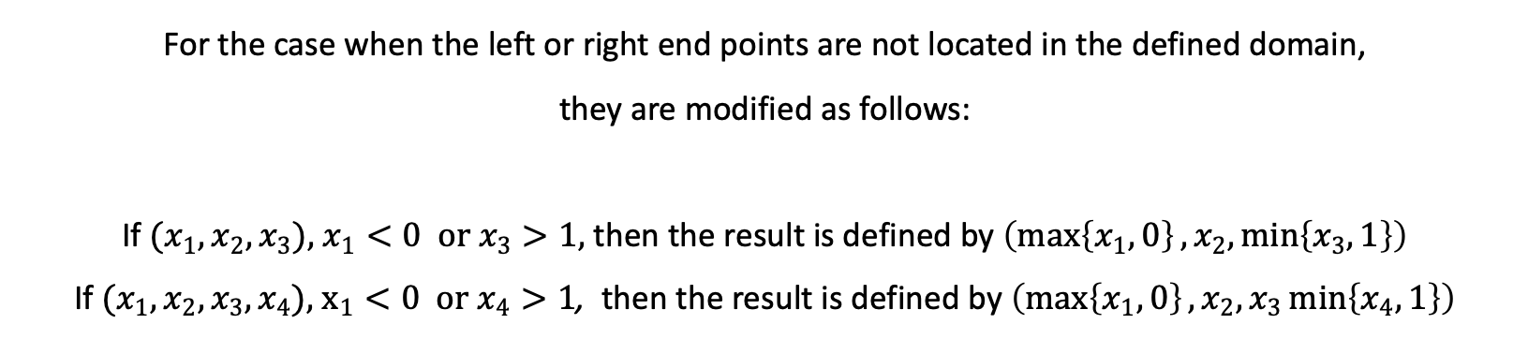
Remark (Modification of fuzzy operations)
For the case when the left or right end points are not located in the defined domain,
they are modified as follows:
If $(x_{1}, x_{2}, x_{3}),$ $x_{1}<0 or x_{3}>1,$ then the result is defined by $\left(\max\left\{x_{1}, 0\right\}, x_{2},\min\left\{x_{3},1\right\}\right)$
If $(x_{1}, x_{2}, x_{3}, x_{4}),$ $x_{1}<0 or x_{4}>1$, then the result is defined by $\left(\max\left\{x_{1}, 0\right\}, x_{2},x_{3}\min\left\{x_{4},1\right\}\right)$
18/29

Slide 19
PART
04
Data Analysis using Fuzzy Post-Evaluation Model

Slide 20
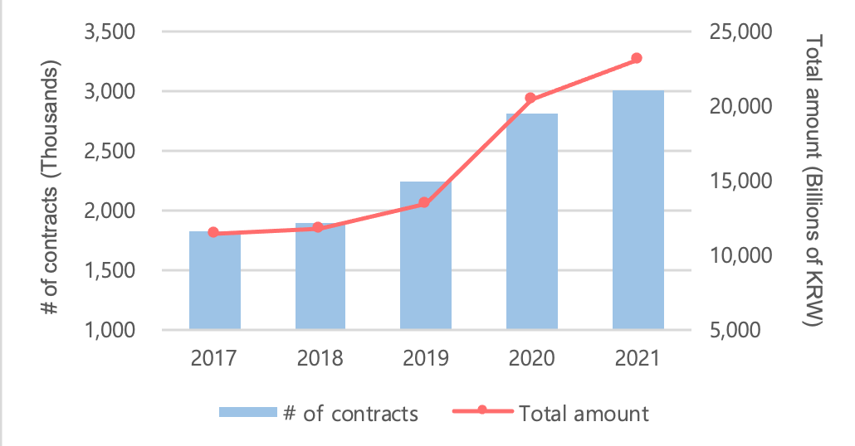
Fuzzy Post-Evaluation Model for PPS of South Korea using one-sided fuzzy reliability function
Table 1. Status of MAS in South Korea
 | 2017 | 2018 | 2019 | 2020 | 2021
Total amount (Billions of KRW) | 11,408 | 11,755 | 13,473 | 20,408 | 23,082
# of contracts (Thousands) | 1,825 | 1,895 | 2,236 | 2,805 | 3,010
The number of contracts increased from 1.8 million to 3 million.
Figure 2. Status of MAS in South Korea
20/29

Slide 21
To evaluate the performance of the proposed model, we generated 5 sample data
Table 3. Sample data for MAS
Company Name | Delivery Observation | Delivery Delay | Defect Care | Quality Sat. | Price Sat. | Service Sat. | Post- Sat. | Supply Ratio | Defect Care Period | Fraud Penalty | Trade Penalty
A | 75 | 10 | 5 | 5 | 4 | 3 | 3 | 76 | 9 | 30 | 45
B | 90 | 4 | 1 | 1 | 5 | 6 | 5 | 90 | 3 | 3 | 6
C | 35 | 20 | 8 | 8 | 1 | 0 | 1 | 43 | 15 | 120 | 130
D | 82 | 7 | 2 | 2 | 5 | 4 | 4 | 87 | 6 | 15 | 30
E | 45 | 17 | 7 | 7 | 3 | 2 | 2 | 50 | 12 | 90 | 80
21/29

Slide 22
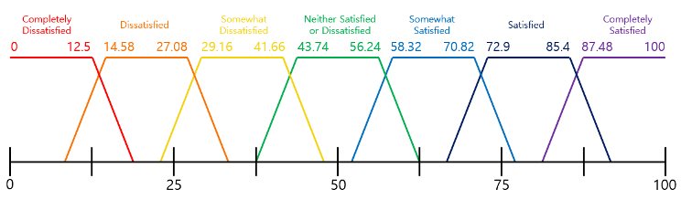
Figure 3. Satisfaction score using trapezoidal fuzzy number
We used 7 point Likert scale for Qualitative categories
like ‘Quality satisfaction’, ‘Price satisfaction’, ‘Service satisfaction’, ‘Post-satisfaction’,
and they are surveyed as percentages of satisfaction
22/29

Slide 23
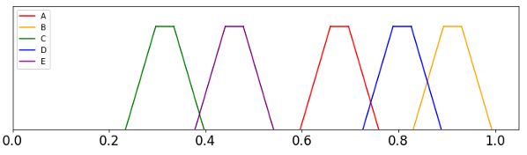
Figure 4. Post-evaluation score using trapezoidal fuzzy numbers
Table 4. Post-evaluation score of 5 companies
Company Name | Fuzzy Score
A | (0.596, 0.659, 0.696, 0.759)
B | (0.831, 0.893, 0.931, 0.993)
C | (0.234, 0.297, 0.334, 0.397)
D | (0.726, 0.789, 0.826, 0.889)
E | (0.378, 0.441, 0.478, 0.541)
Also each quantitative category is considered as an interval
instead of one number for interval operation with fuzzy numbers
23/29

Slide 24
Fuzzy Post-Evaluation Model for using two-sided fuzzy reliability function
Table 5. Sample Data for Delivery Service
Store | Arrival Time1 | Score1 | Arrival Time 2 | Score 2 | ArrivalTime3 | Score 3 | Arrival Time 4 | Score 4 | Arrival Time 5 | Score 5
A | 11:50 | 20 | 11:42 | 12 | 12:24 | 54 | 12:11 | 41 | 11:45 | 15
B | 12:01 | 31 | 12:03 | 33 | 11:54 | 24 | 12:08 | 38 | 11:57 | 27
C | 12:24 | 54 | 12:30 | 60 | 11:31 | 1 | 11:33 | 3 | 12:29 | 59
D | 11:47 | 17 | 11:52 | 22 | 12:01 | 31 | 11:58 | 28 | 12:11 | 41
E | 12:14 | 44 | 11:39 | 9 | 11:30 | 0 | 12:28 | 58 | 11:54 | 24
Let's consider the delivery system. If a customer instructs them to deliver some items at a certain time,
the customer will be less satisfied if they ship earlier or later than that time.
To compare the results using two different operations
we generated five sample data
24/29

Slide 25
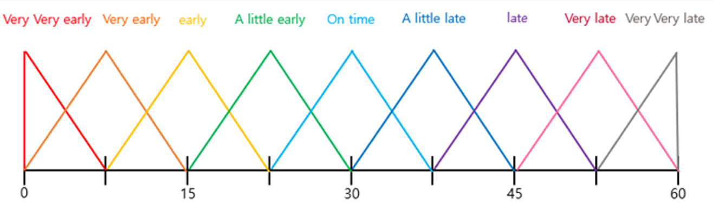
Figure 5. Post-Evaluation score using triangular fuzzy numbers
25/29

Slide 26
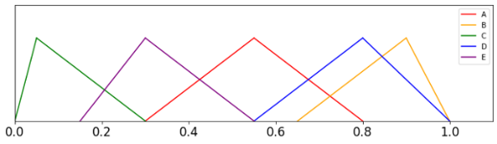
Results using fuzzy operations with function principle
Figure 6. Fuzzy post-evaluation scores of the delivery service data calculated by function principle
Table 6. Fuzzy post-evaluation scores of the delivery service data calculated by function principle
Store | Fuzzy post-evaluation score
A | [0.3, 0.55, 0.8]
B | [0.65, 0.9, 1.0]
C | [0.0, 0.05, 0.3]
D | [0.55, 0.8, 1.0]
E | [0.15, 0.3, 0.55]
the delivery service of each store is not always the same
some differences can occur from situation to situation
the fuzzy post-evaluation score shows the attributes of the given data better
26/29

Slide 27
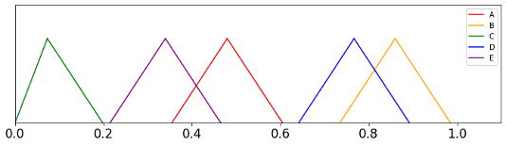
Results using fuzzy operations with fixed spread
Figure 9. Fuzzy post-evaluation scores of the delivery service data calculated by fixed spread
Table 7. Fuzzy post-evaluation scores of the delivery service data calculated by fixed spread
Store | Fuzzy post-evaluation score
A | (0.355, 0.48, 0.605)
B | (0.735, 0.86, 0.985)
C | (0.0, 0.073, 0.198)
D | (0.642, 0.767, 0.892)
E | (0.215, 0.340, 0.465)
fixed spread symmetric triangular fuzzy numbers
The results using fuzzy operations with fixed spread
reflect the characteristics of variables better than those of function principle
27/29

Slide 28
PART
05
Conclusions

Slide 29
Conclusion
When comparing data,
Our newly defined fuzzy operations are more helpful than the existing defined fuzzy operations
If qualitative indicators are fuzzified with our post-valuation function,
it is possible to evaluate indicators without loss of information
This study can be applied in all situations where this post-evaluation system is required
29/29

Slide 30
References
[1] Derringer,G., Suich,R.(1980),"Simultaneous surface optimization of Several Response Variables", Journal of Quality, Vol.27, No.1, pp.34-39
[2] 윤지호(2007), “다수공급자물품계약제도에서의 공공조달업체 사후평가 모델에 관한 연구”, 명지대학교 석사학위논문, 1-61
[3] Manoj Kumar, Prem Vrat, R. Shankar. (2004), “A fuzzy goal programming approach for vendor selection problem in a supply chain”, Computers & Industrial Engineering, Vol 46, Issue 1, pp.69-85
[4] Manoj Kumar, Prem Vrat, Ravi Shankar. (2006), “A fuzzy programming approach for vendor selection problem in a supply chain”, International Journal of Production Economics, Vol 101, Issue 2, pp.273-285
[5] 이광형, 오길록, "퍼지이론 및 응용 1권 : 이론", 홍릉과학출판사(1991 (L. A. Zadeh, “Fuzzy Sets”, Information and Control, vol. 8, pp. 338-353, 1965.)
[6] 박광하, "조달청·경기도 "조달 행정 공정성 강화" 각자 선언", 정보통신신문, 2021.03.26, https://www.koit.co.kr/news/articleView.html?idxno=81397
[7] 김연균, "다수공급자계약 ‘예산 절감 기회 상실 사례 확인", 정보통신신문, 2021.06.17, https://www.koit.co.kr/news/articleView.html?idxno=85843
[8] https://m.khan.co.kr/national/national-general/article/202109140803001#c2b (2021.09.14)
[9] URL:https://www.pps.go.kr/kor/index.do, (2022. 2.15)
[10] Public Procurement Training Institute, https://www.pps.go.kr/hrd/home/UserBoardActionUpdate.do?method=detail&BO_CODE=REFERENCE_ROOM&BO_IDX=4301&ROOT_MENU=MENU002&CHILD_MENU=MENU209&searchText=&pageLine=10&pageNo=10
[11] 물품 다수공급자계약 업무처리규정.hwp
http://www.gmas.or.kr/02.information/regulation.jsp?MENUCODE=020400&PAGENO=1&SELECT=&KEYWORD=&SELECT2=&KEYWORD2=&SELECT3=&KEYWORD3=&JOB=read&SEQ=17&TYPE=0&&TABLENAME=BOARD_REGULATION
[12] 조달청 데이터 활용 : 조달정보개방포털 - 종합쇼핑몰 납품요구 상세내역
[3] Countryeconomy.com, “US Federal Reserve Bank key
rates,” 2020, Available https://countryeconomy.com/keyrates/
usa.
[4] Bloomberg, “title of news article,” 2021, Available http:
//www.bloomberg.com/news.
[5] Bank of Korea, “Economic statistics system,” 2020, Available
http://ecos.bok.or.kr/.
[9] Yonhap News, “‘Korea has made a difference’ : : :
Main institutions raise their growth rate forecast
this year,” 2021, Available https://www.yna.co.kr/view/
AKR20210126166300002.
[10] Korea Economic Daily, “Korea’s second largest GDP per
capita in 2050,” 2011, Available https://www.hankyung.
com/international/article/2011052023431.
[11] L. A. Zadeh. Fuzzy sets. Information and Control, 8:338–353, 1965.
30/29

Slide 31
THE END
THANK YOU
THE END

